Slide 1
Vaccine Equity Group 1
Sponsor: BU Spark!
Client: Dr. Julia Koehler
Leland Ling, Kristi Li, Brian Tao, Yu Yan

Slide 2
Background & Motivation
Less represented minority groups generally get the shorthand of the stick.
La Colaborativa has been working in Chelsea since the beginning of Covid.
We focused on racial data because the scope of looking at both age data and racial data is too large.
Group 2 looked at age data.

Slide 3
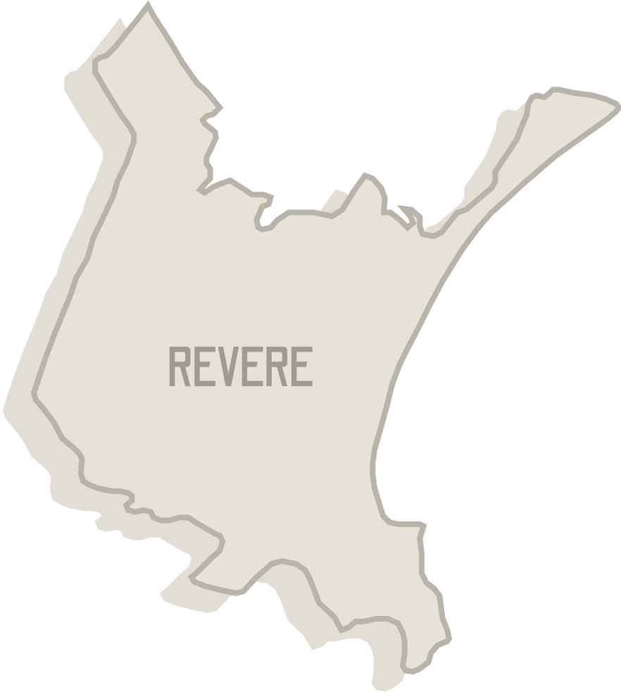
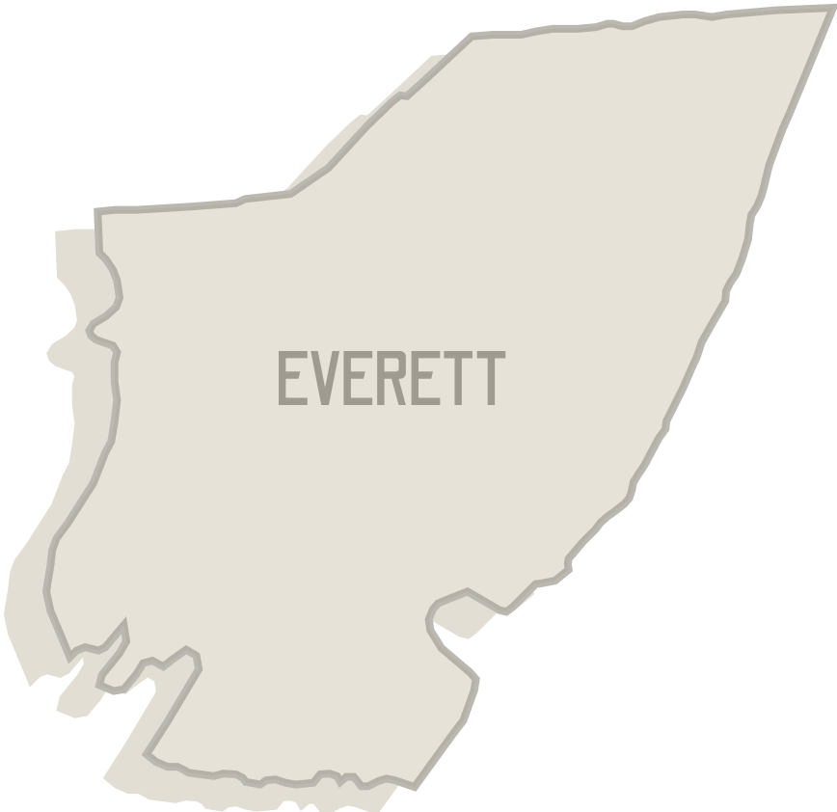
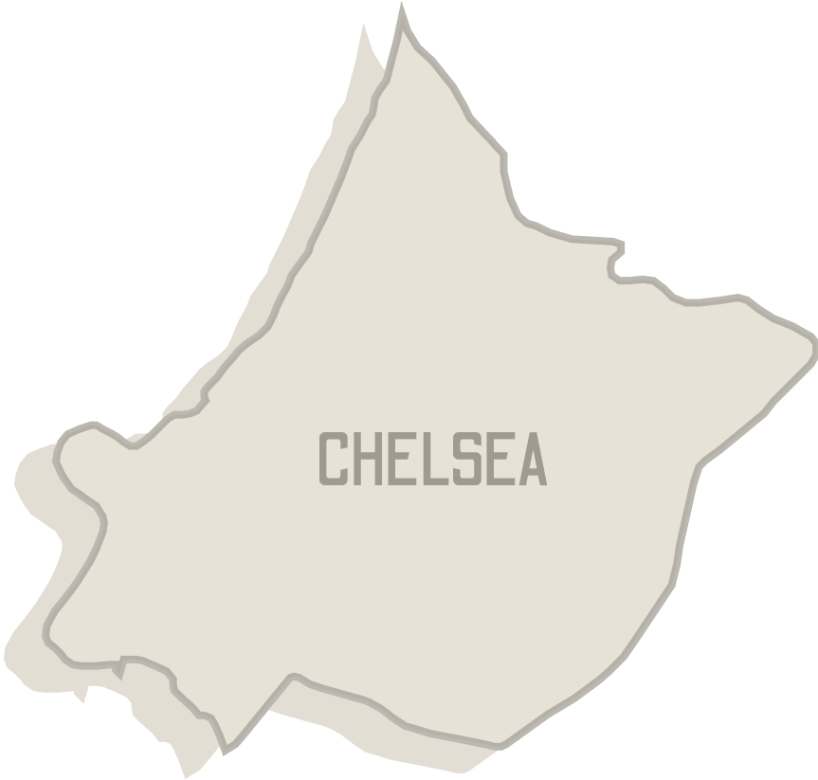

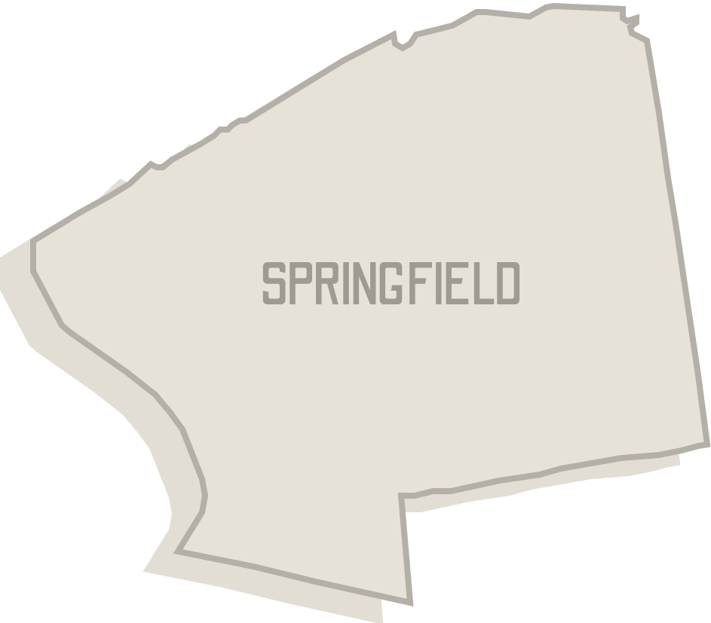

Goals
To find disparities within vaccination rollout in Everett, Springfield, Newton, Wellesley, Chelsea, and Revere.
To visualize the effects of La Colaborativa on Chelsea and to discern a qualitative difference between the communities that have grassroots support and those that do not.
Underserved Communities
Underserved Communities
with Grassroot Support
Better-served Communities

Slide 4
Dataset Cleaning
Earlier times are missing 2 booster vaccinations
Booster was not out yet. We didn’t make any changes and considered these time periods as completely separate.
Older times: missing partially vaccinated
Filled out with one dose - fully vaccinated
Missing infant data for most times
Filled out missing data as 0
In the County/City Age, the partially_vaccinated data of Wellesley city from line 2396 to 2403 were shifted up by one row, so we shifted them down by one row.

Slide 5
Dataset Preliminary Analysis
We used T-test to explore the similarities and differences of each city’s vaccination data.
Rule: if the result p-value is greater than 0.05, we can say that the data distributions being compared are statistically similar and reject hypothesis.
Findings:
Percentage of vaccinated population:
Hispanic and White data of Chelsea and Newton
Black and Hispanic data of Chelsea and Revere
Black data of Chelsea and Springfield
Rate of changes of percentage of fully vaccinated data
p-values are all above 0.05, ranging from 0.21 to 0.98
No significant differences
Notes:
We applied the T-test to compare each and every city’s racial data. Hypothesis was that the data distributions were similar, and null hypothesis was that they are dissimilar. If the p value was above 0.05, then we reject the hypothesis and state that the distributions are the same

Slide 6
City Data vs. % of Individuals Fully Vaccinated
Each line corresponds to a region, and each graph corresponds to a race.

Slide 7
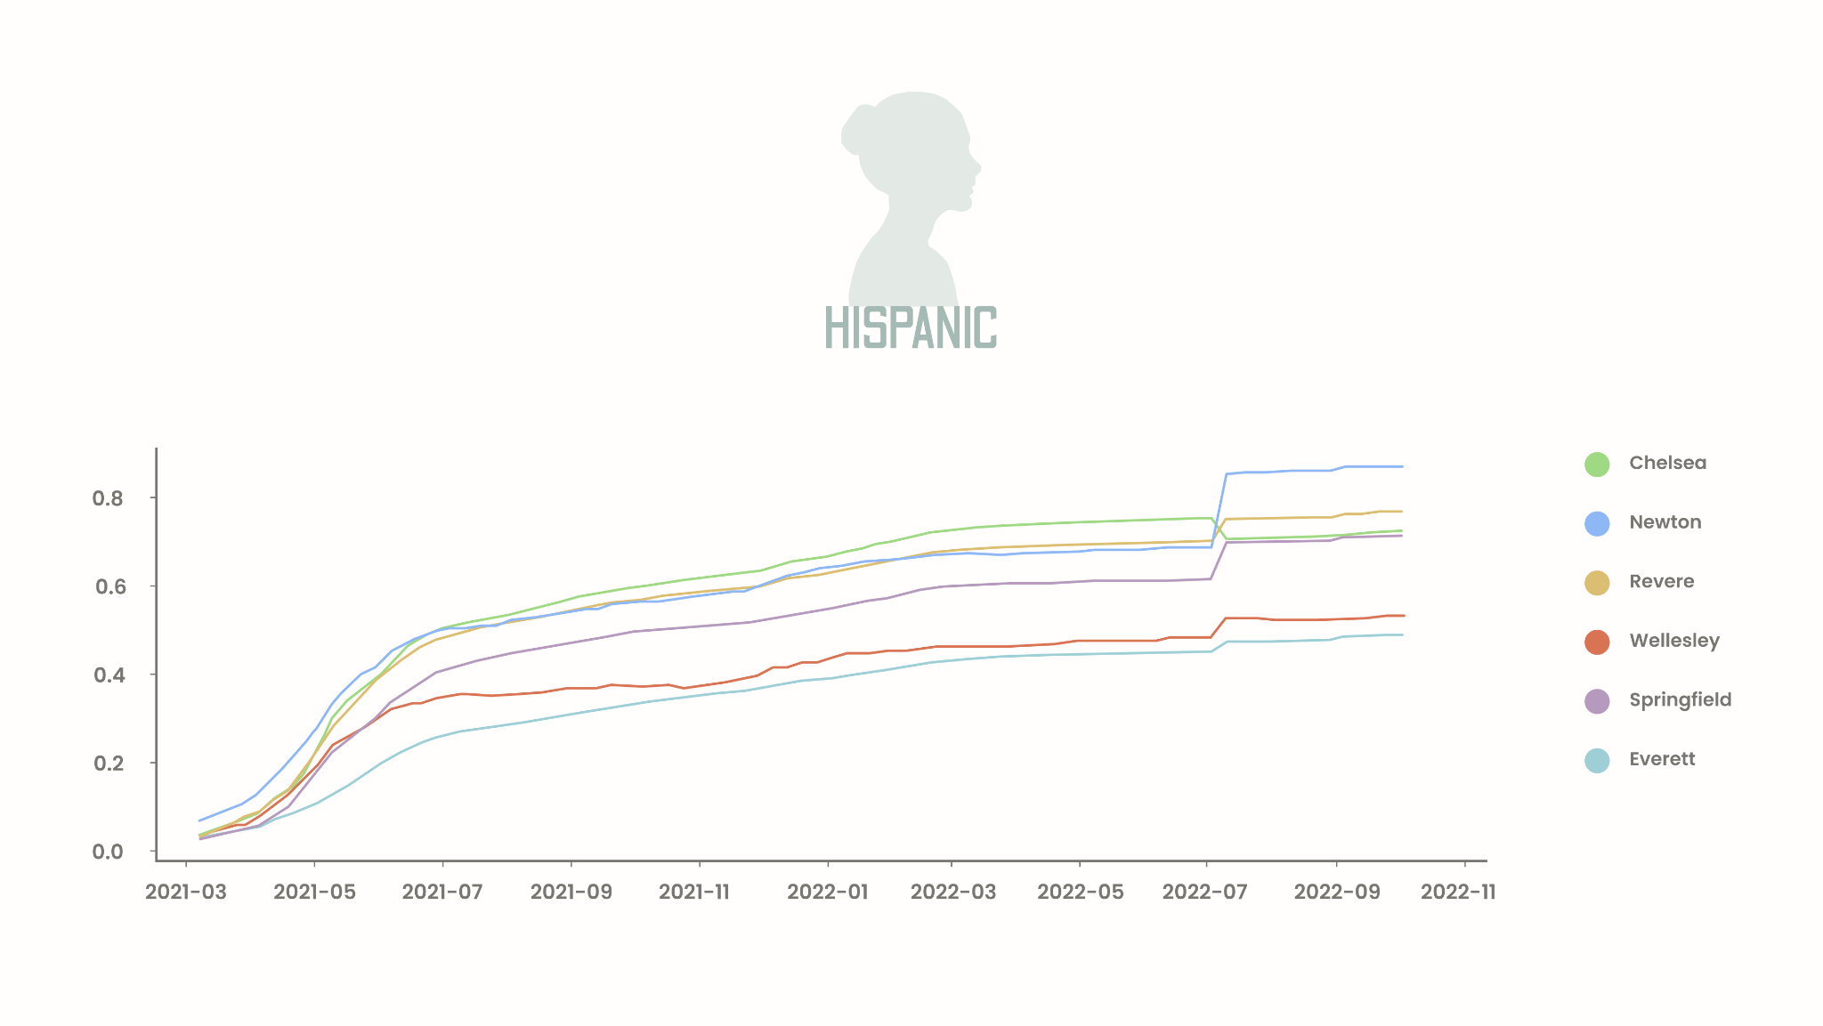
Notes:
07/2022 is the time point when booster two rollout begins
Chelsea vs. Newton
Hispanic
stat=-0.113, p=0.91052820
Probably the same distribution
Chelsea vs. revere
Hispanic
stat=0.622, p=0.53475560
Probably the same distribution
Chelsea vs. wellesley
Hispanic
stat=7.462, p=0.00000000
Probably different distributions
Chelsea vs. springfield
Hispanic
stat=9.148, p=0.00000000
Probably different distributions
Chelsea vs. everett
Hispanic
stat=2.951, p=0.00363799
Probably different distributions

Slide 8
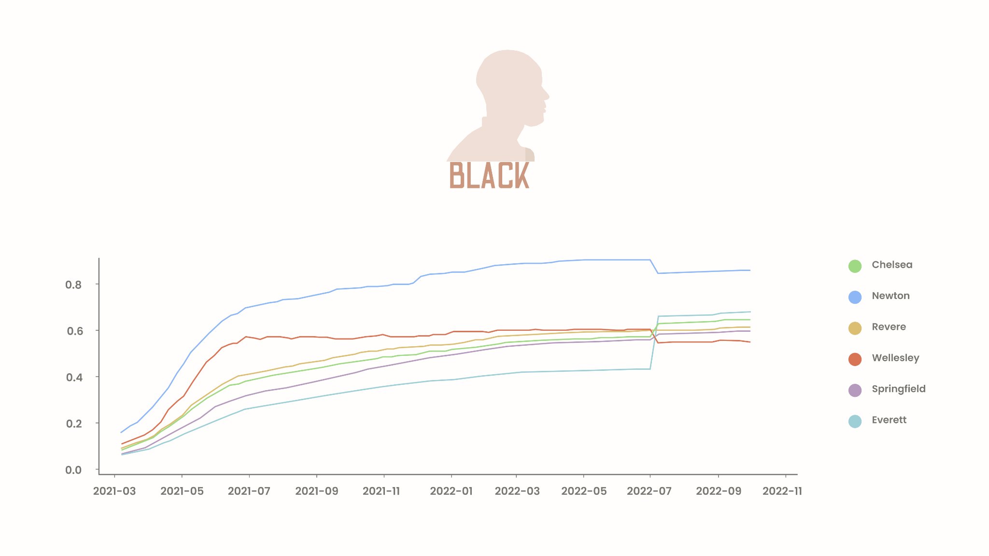
Notes:
Chelsea vs. Newton
Black
stat=-10.864, p=0.00000000
Probably different distributions
Chelsea vs. revere
Black
stat=-0.725, p=0.46959120
Probably the same distribution
Chelsea vs. wellesley
Black
stat=-2.779, p=0.00611275
Probably different distributions
Chelsea vs. springfield
Black
stat=1.593, p=0.11317241
Probably the same distribution
Chelsea vs. everett
Black
stat=3.943, p=0.00011944
Probably different distributions

Slide 9
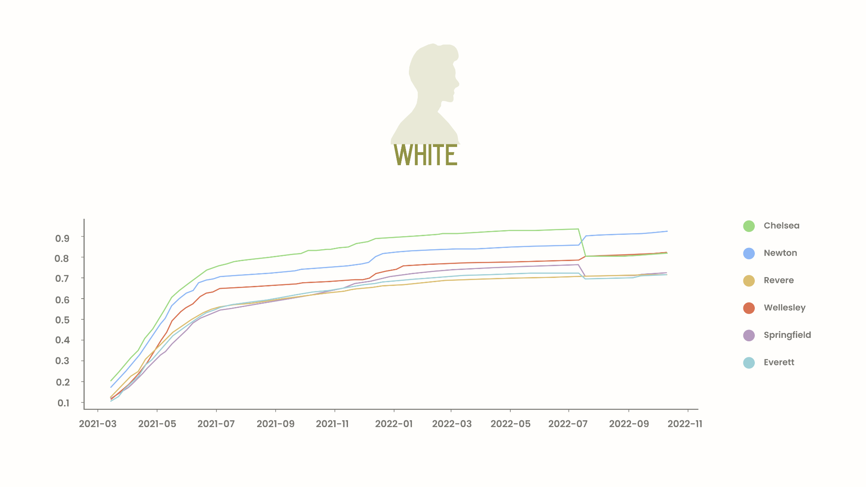
Notes:
Chelsea vs. Newton
White
stat=1.601, p=0.11119134
Probably the same distribution
Chelsea vs. revere
White
stat=7.675, p=0.00000000
Probably different distributions
Chelsea vs. wellesley
White
stat=4.463, p=0.00001497
Probably different distributions
Chelsea vs. springfield
White
stat=6.618, p=0.00000000
Probably different distributions
Chelsea vs. everett
White
stat=7.226, p=0.00000000
Probably different distributions

Slide 10
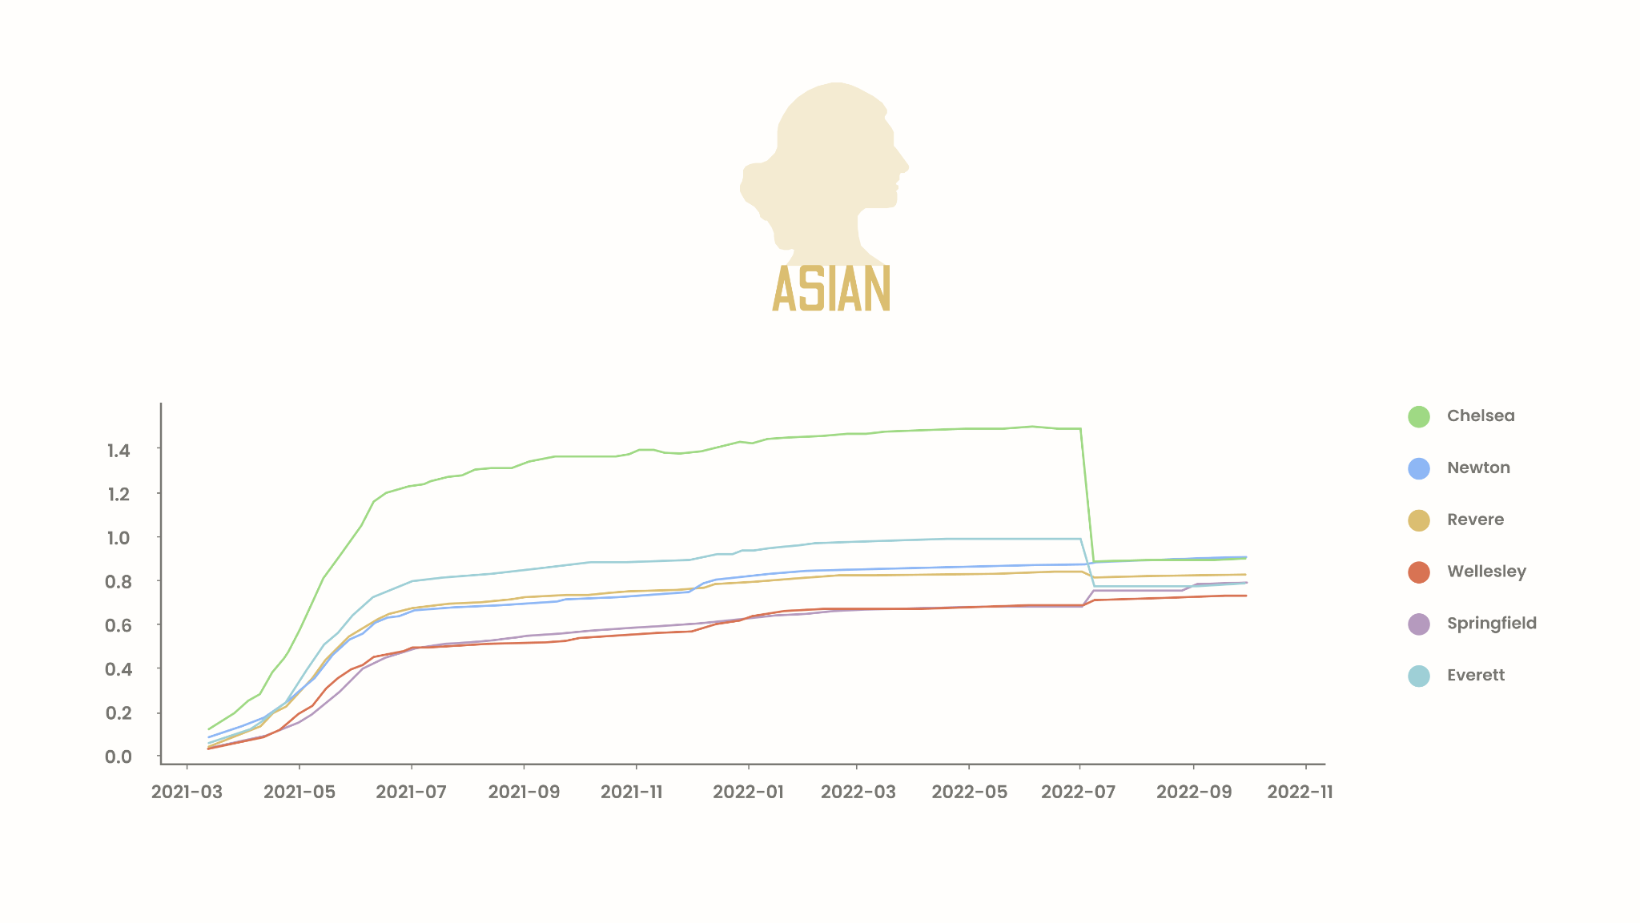
Notes:
Issue with asian data being above 100% is sample size - Chelsea asian population is 800, observed number of individuals fully vaccinated is 1000-1200.
Chelsea vs. Newton
Asian
stat=9.869, p=0.00000000
Probably different distributions
Chelsea vs. revere
Asian
stat=10.377, p=0.00000000
Probably different distributions
Chelsea vs. wellesley
Asian
stat=13.896, p=0.00000000
Probably different distributions
Chelsea vs. springfield
Asian
stat=13.536, p=0.00000000
Probably different distributions
Chelsea vs. everett
Asian
stat=7.964, p=0.00000000
Probably different distributions

Slide 11
City Data vs. Rate of Change in Percentage of Individuals Fully Vaccinated
Each line corresponds to a region, and each graph corresponds to a race.
Notes:
Plot in an additive manner
Survival curves - each event is a step down,
Cumulative proportion
Kruskal wallis - survival

Slide 12
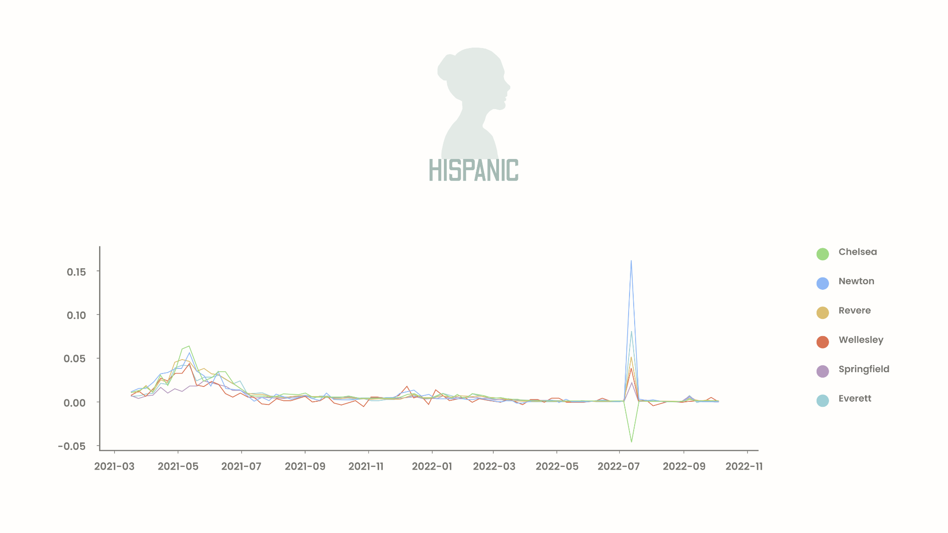
Notes:
Chelsea vs. Newton
Hispanic
stat=-0.504, p=0.61484125
Probably the same distribution
Chelsea vs. revere
Hispanic
stat=-0.256, p=0.79806534
Probably the same distribution
Chelsea vs. wellesley
Hispanic
stat=1.255, p=0.21145199
Probably the same distribution
Chelsea vs. springfield
Hispanic
stat=1.704, p=0.09118182
Probably the same distribution
Chelsea vs. everett
Hispanic
stat=0.015, p=0.98783136
Probably the same distribution

Slide 13
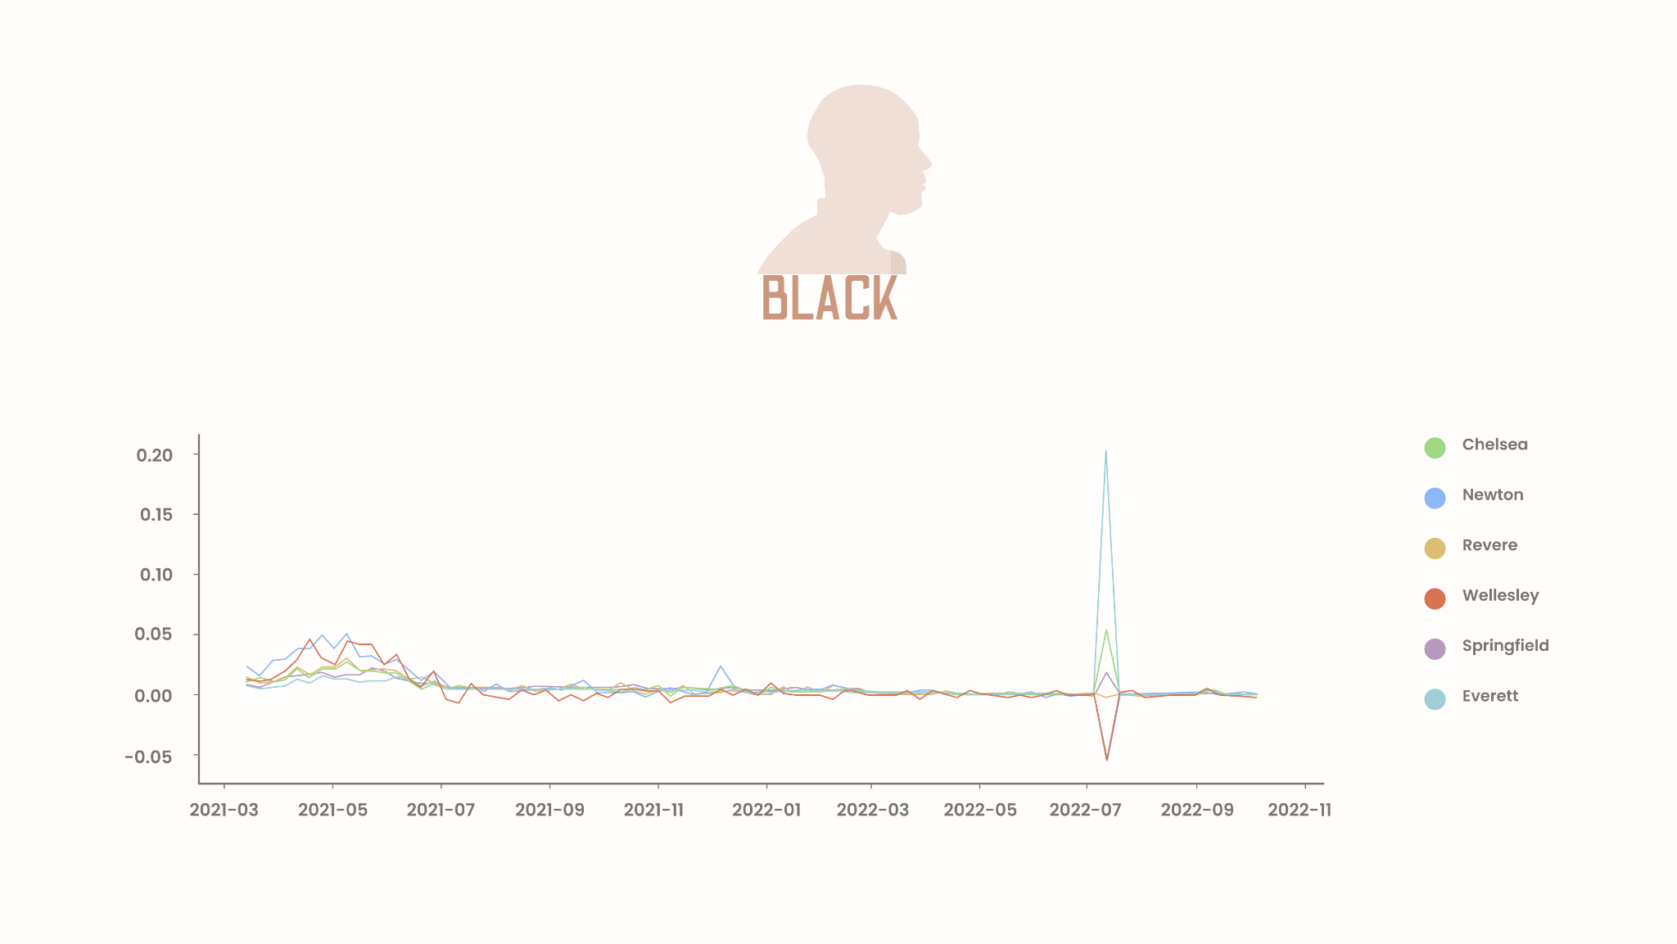
Notes:
Chelsea vs. Newton
Black
stat=-0.848, p=0.39819699
Probably the same distribution
Chelsea vs. revere
Black
stat=0.344, p=0.73133018
Probably the same distribution
Chelsea vs. wellesley
Black
stat=0.760, p=0.44888363
Probably the same distribution
Chelsea vs. springfield
Black
stat=0.313, p=0.75467528
Probably the same distribution
Chelsea vs. everett
Black
stat=-0.219, p=0.82672146
Probably the same distribution

Slide 14
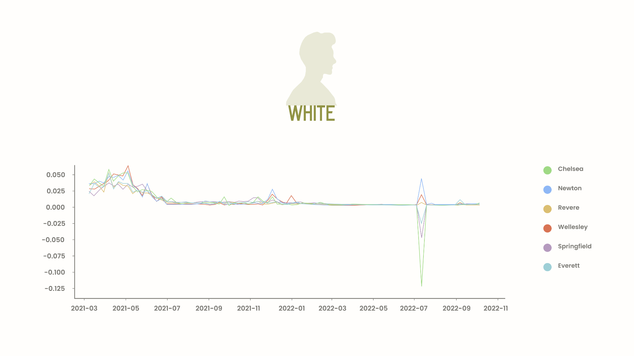
Notes:
Chelsea vs. Newton
White
stat=-0.577, p=0.56468331
Probably the same distribution
Chelsea vs. revere
White
stat=0.088, p=0.93027658
Probably the same distribution
Chelsea vs. wellesley
White
stat=-0.397, p=0.69213862
Probably the same distribution
Chelsea vs. springfield
White
stat=0.054, p=0.95672988
Probably the same distribution
Chelsea vs. everett
White
stat=0.028, p=0.97758631
Probably the same distribution

Slide 15
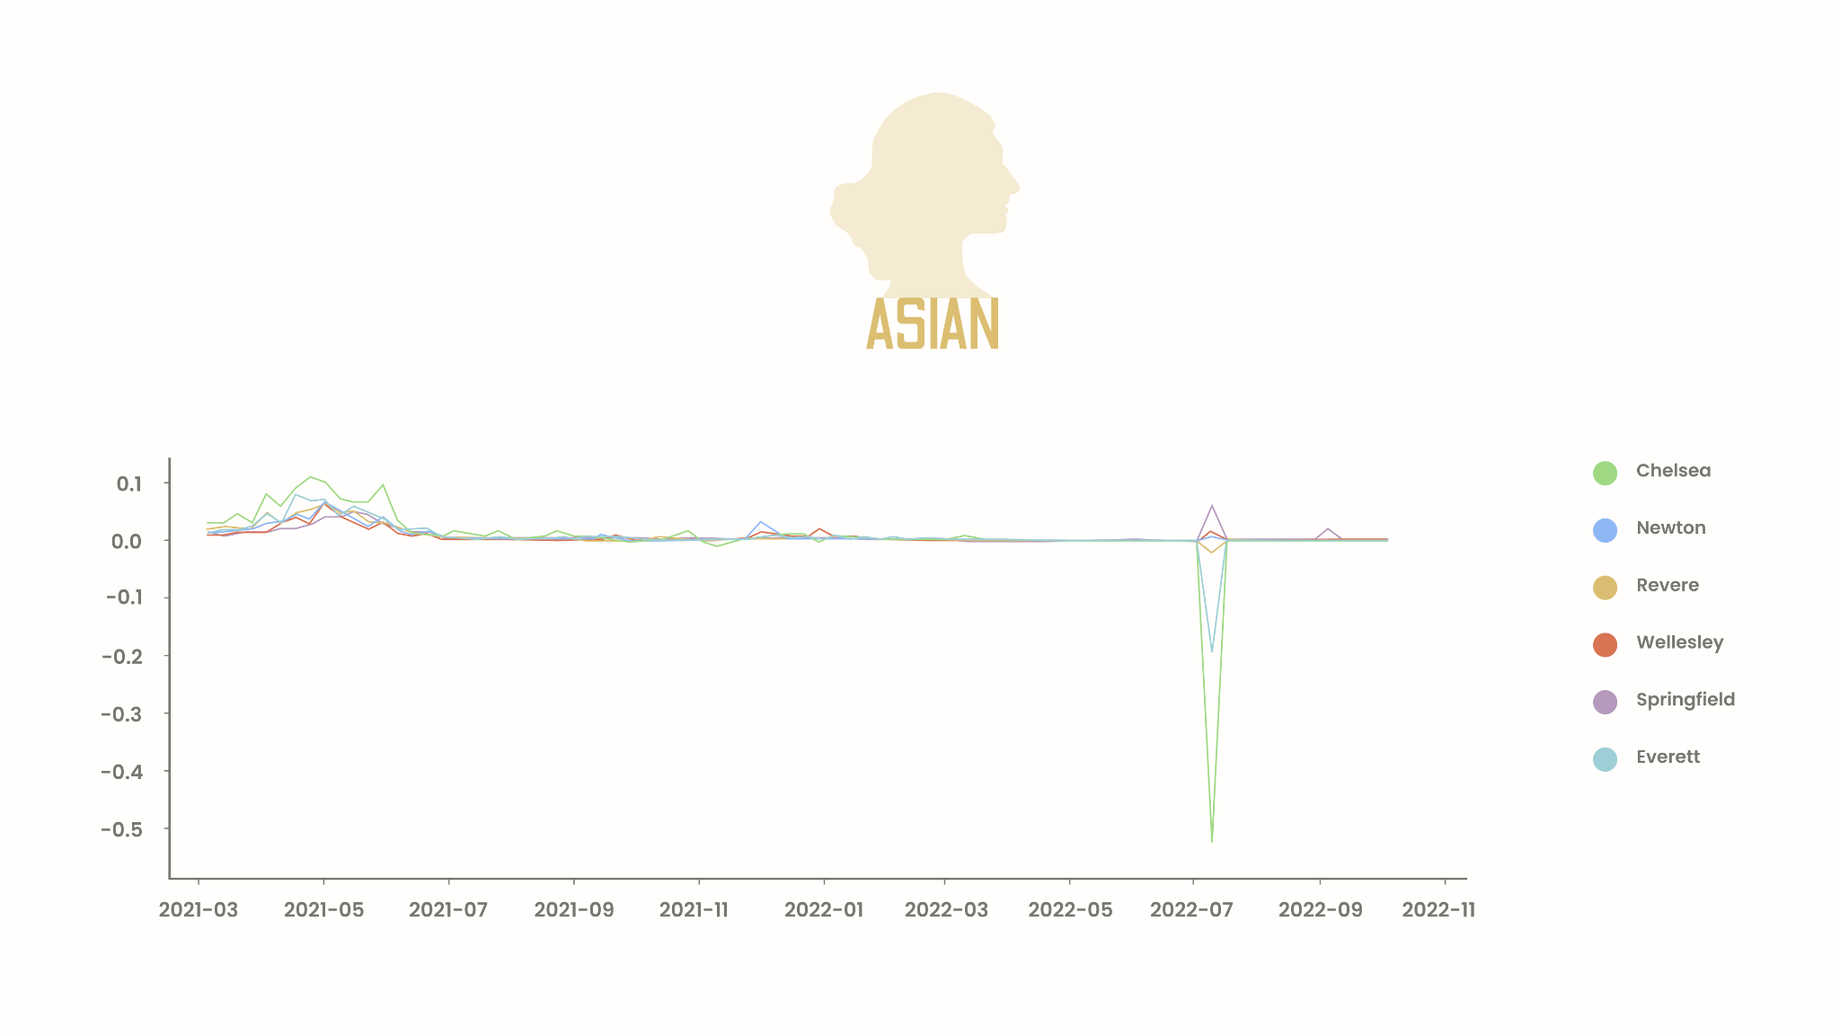
Notes:
Chelsea vs. Newton
Asian
stat=-0.065, p=0.94816446
Probably the same distribution
Chelsea vs. revere
Asian
stat=-0.015, p=0.98801333
Probably the same distribution
Chelsea vs. wellesley
Asian
stat=0.112, p=0.91115461
Probably the same distribution
Chelsea vs. springfield
Asian
stat=0.029, p=0.97710721
Probably the same distribution
Chelsea vs. everett
Asian
stat=0.060, p=0.95228361
Probably the same distribution

Slide 16
City Data vs. Rate of Change in Percentage of Individuals Fully Vaccinated
2021-11-01 to 2022-02-15
Each line corresponds to a region, and each graph corresponds to a race.
Notes:
Plot in an additive manner
Survival curves - each event is a step down,
Cumulative proportion
Kruskal wallis - survival

Slide 17
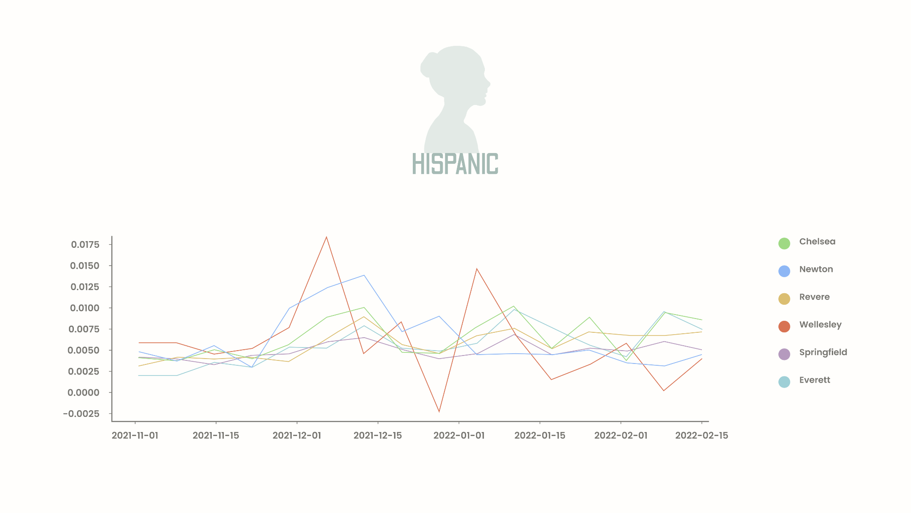

Slide 18
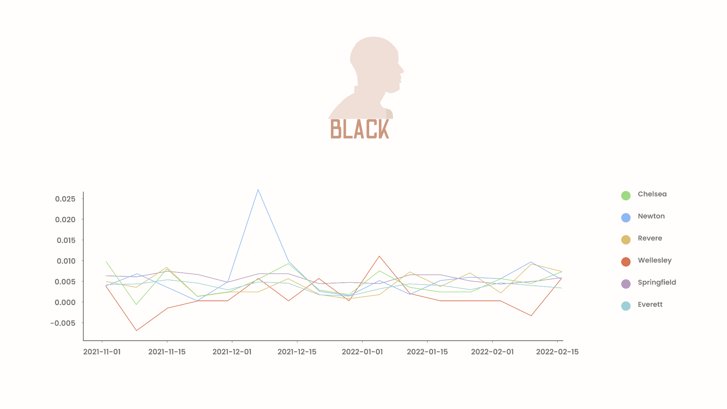

Slide 19
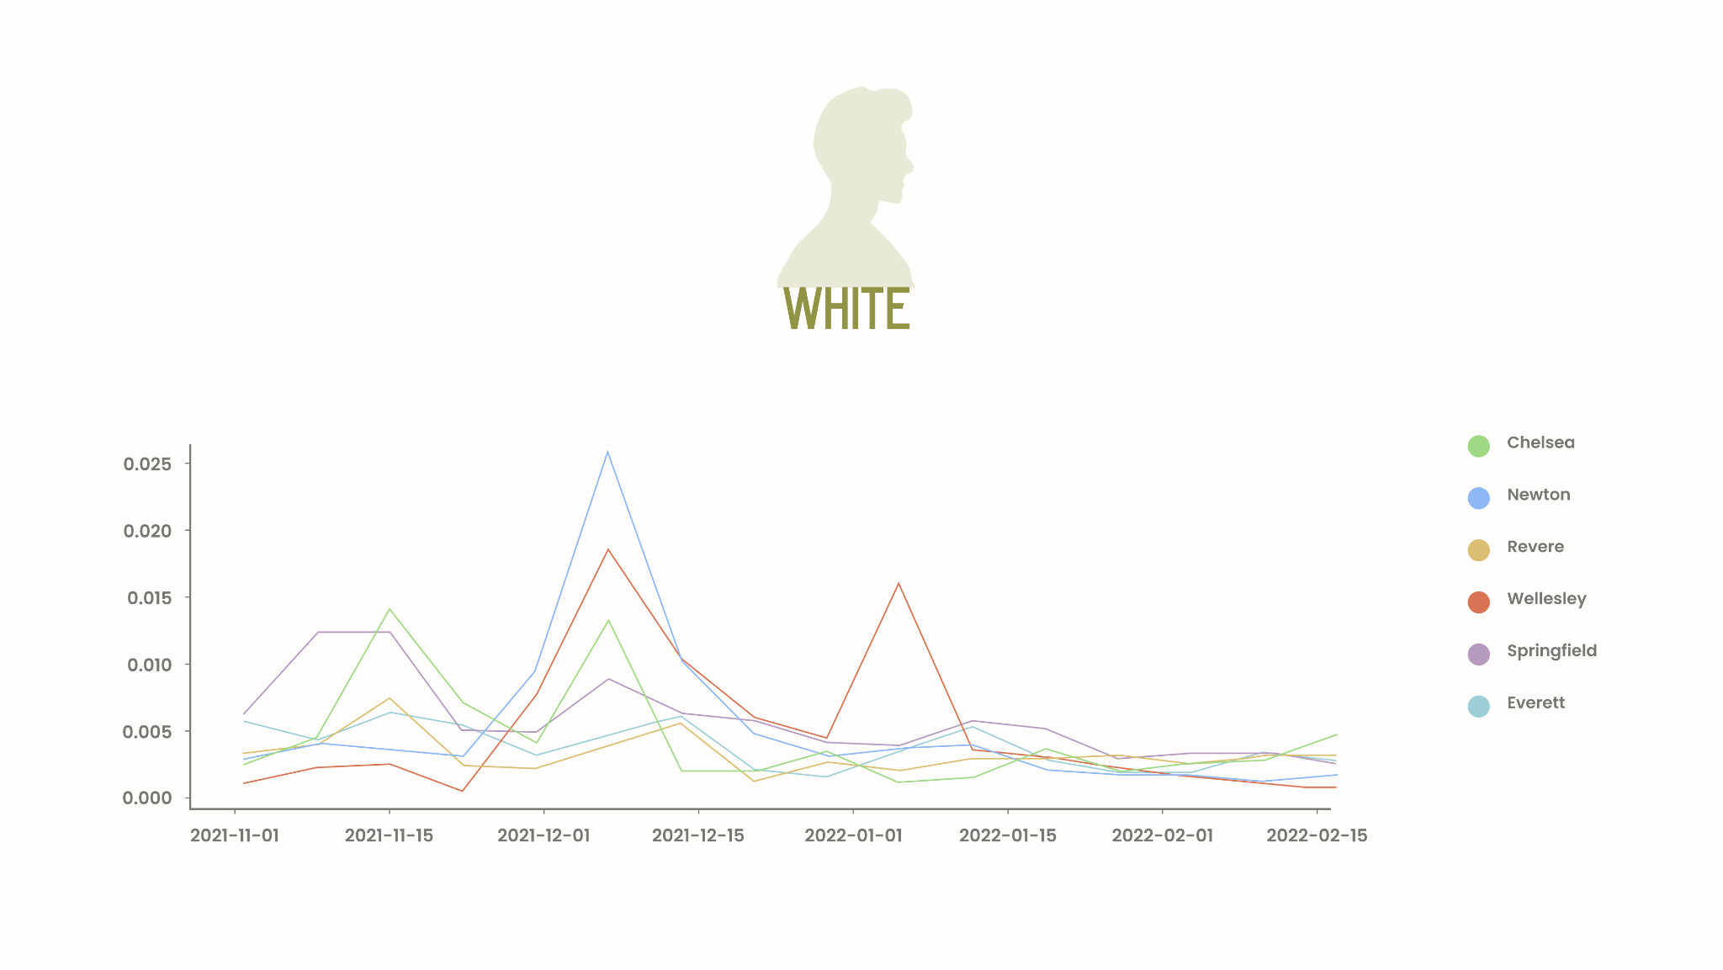

Slide 20
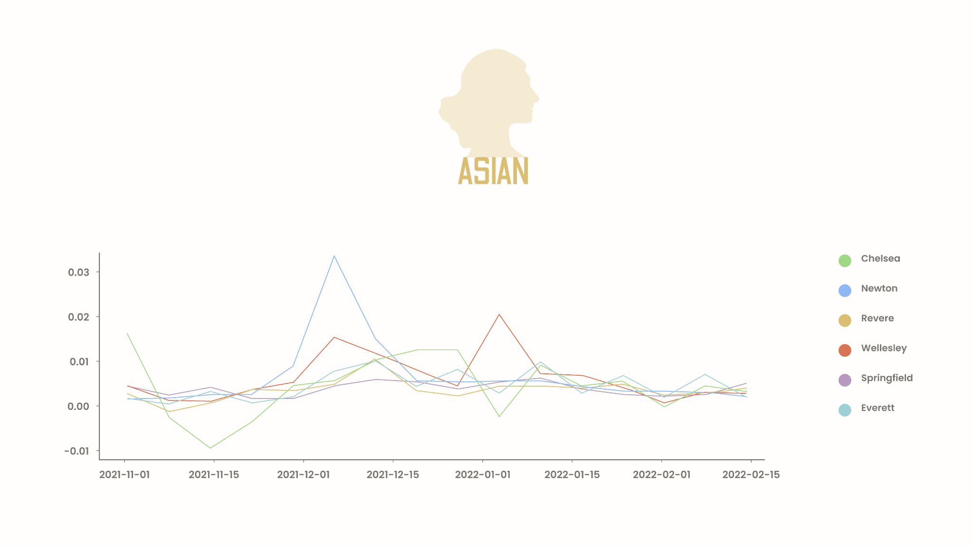

Slide 21
Questions Answered
Do grassroots organizations have a statistically significant effect on vaccination rollout?
What are the factors that affect vaccination rates in the data that we are seeing?
Does the rate of vaccination change as La Colaborativa was able to do more work in the community?
Are there changes in the vaccination rate resulting from La Colaborativa’s efforts?

Slide 22
01
Do grassroots organizations have a statistically significant effect on vaccination rollout?
Chelsea’s distribution of data matches Newton’s more than the other cities, possibly due to La Colaborativa’s efforts. However, correlation is not causation and we must not err to assume that La Colaborativa is the reason that this similarity exists.

Slide 23
02
What are the factors that affect vaccination rates in the data that we are seeing?
Race is a factor that heavily influences vaccination rates. We found that Hispanic demographics between Chelsea and Newton have similar distributions when comparing the rate of change in percentage of population that is fully vaccinated.

Slide 24
03
Does the rate of vaccination change as La Colaborativa was able to do more work in the community?
Couldn’t be answered without knowing a clear timeline of La Colaborativa’s efforts.

Slide 25
04
Are there changes in the vaccination rate resulting from La Colaborativa’s efforts?
Couldn’t be answered without knowing a clear timeline of La Colaborativa’s efforts.

Slide 26
Challenges Faced
2 Issues
The data collection error could be an issue for all demographics – however, there is no easy way to fix this for all data points as we don’t know what to use as ground truth for the population.
While we can discern that there is a qualitative and quantitative difference between Chelsea and the other graphs, without a timeline to La Colaborativa’s efforts, we cannot pin these differences to specific events in the timeline we observed.

Slide 27
Next steps
Hypothesis testing on smaller time intervals
Analysis on La Colaborativa's timeline and its effects upon Chelsea’s populations
Perform same analysis on the zipcode dataset

Slide 28
Works Cited
“SARS and MERS”, Baylor College of Medicine: Department of Molecular Virology and Microbiology,https://www.bcm.edu/departments/molecular-virology-and-microbiology/emerging-infections-and-biodefense/specific-agents/sars-mers
Health, Department of Public, and Executive Office of Health and Human Services. “Covid-19 Response Reporting.” Mass.gov, https://www.mass.gov/info-details/covid-19-response-reporting.
COVID-data_Massachusetts-vaccines,https://docs.google.com/spreadsheets/d/1FaXay9eNR48sZ2rdeivH8vldMBZsuWagdbF3ub9y-tU/edit#gid=1069676523
Health, Department of Public. “Massachusetts Covid-19 Vaccination Data and Updates.” Mass.gov, https://www.mass.gov/info-details/massachusetts-covid-19-vaccination-data-and-updates.
COVID-data_Massachusetts-vaccines_zipcodes, https://docs.google.com/spreadsheets/d/1MbJO8Va82DHuzvxtNSwEWju8ZUhiZJgzZblrSVrD4Yk/edit#gid=1096893525
Pearson, Helen. “Caution raised over SARS vaccine.” Nature, 10 Jan. 2005, doi:10.1038/news050110-3
BU-Spark. “DS-Vaccine-Equity/hypothesistesting_consolidated.Ipynb at Dev · Bu-Spark/DS-Vaccine-Equity.” GitHub, https://github.com/BU-Spark/ds-vaccine-equity/blob/dev/fall22-team-1/Deliverable%204/hypothesisTesting_Consolidated.ipynb.
“From COVID ‘Hotspot’ to #1 in Vaccinations” La Colaborativa 7 Oct. 2021, https://la-colaborativa.org/2021/10/07/from-covid-hotspot-to-1-in-vaccinations/
“Opening Our Doors: Covid Vaccines Now Available at La Colaborativa.” La Colaborativa, 4 Feb. 2021, https://la-colaborativa.org/2021/02/04/opening-our-doors-covid-vaccines-now-available-at-la-colaborativa/.

Slide 29
Thank You!

